Slide 1
Hypertension in pregnant Women
Gestational hypertension

Slide 2
Outline of seminar :
Introduction
Classification for each types.
Define of each types.
Causes and risk factors for each types
clinical manifestation of each types .
diagnosis for each types
management for each types,
Aim of seminar ) effect of hypertension on mother and her fetus(
prevention and control of each types .

Slide 3
Introduction
Hypertension is the most common medical problem during pregnancy, complicating up to 10% of pregnancies Hypertensive disorders during
pregnancy are classified into 5 categories:
1-preclampsia
2-eclampsia
3- Gestational hypertension
4-Chronic hypertension
-5Chronic hypertension superimposed preeclampsia

Slide 4
Define for each types
1-Preeclampsia
is a complication of pregnancy marked by hypertension 140/90mmHg and high level of proteinuria Preeclampsia, usually appears after 20weeks of gestation, or postpartum. Approximately 5-8% of all pregnancies are affected by preeclampsia
Risk factors :
1- history of high blood pressure prior to pregnancy
2- history of preeclampsia in previous pregnancies
3-having a mother or sister who had preeclampsia
4- history of obesity
5-multiple pregnancy (carrying more than one baby)
6-History of diabetes, kidney disease, rheumatoid arthritis

Slide 5
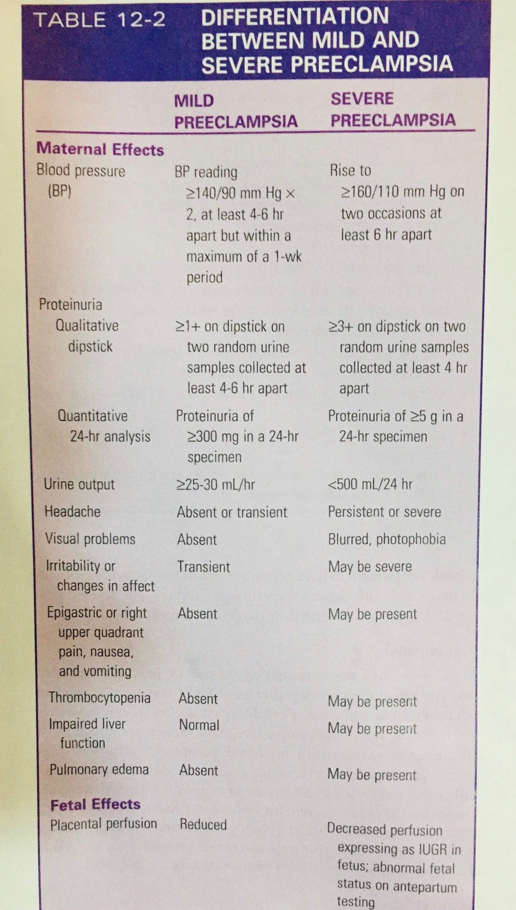

Slide 6
Clinical manifestations,Diagnostic test .
Preeclampsia clinical manifestations | Preeclampsia diagnostic tests
Rapid weight gain (caused by body fluid and seen as swelling in face, hands, and feet) Abdominal pain Severe headaches Reduced urine output Dizziness Excessive nausea and vomiting Visual changes (blurry vision, flashing lights, floaters) | Proteinuria (in24 hour urine collection) Obstetrical Ultrasound and Doppler uric acid - Urea, creatinine, electrolytes, Liver function Test and Fetal heart monitoring.

Slide 7
Nursing role, control and prevention
pre-eclampsia Nursing role | pre-eclampsia control and prevention .
balance -Bed rest Monitoring Blood pressure every 4hours diuresis, proteinuria, fetal move- ment and fetal heart beats (every day) body weight every day and the beast at morning at same time Maintain input and output sedative drug may be take to reduce anxiety . | 1-Diet: Supplementation with a balanced protein and energy diet does not appear to reduce the risk of pre-eclampsia 2-Aspirin Taking aspirin is associated with a 1 to 5% reduction in pre-eclampsia and a 1 to 5% reduction in premature births in women at high risk 3-Physical activity 4-avoid smoking .

Slide 8
2- Eclampsia
Onset of convulsion/generalized seizures in a woman with pre-eclampsia that can not be attributed to other causes
Risk Factors :
1-if have had preeclampsia, you may be at risk for eclampsia.
2-gestational or chronic hypertension (high blood pressure)
3-being older than 35 years or younger than 20 years
4-pregnancy with twins
5-first-time pregnancy
6-diabetes or another condition that affects your blood vessels and kidney disease

Slide 9
Clinical manifestations,Diagnostic tests.
Of Eclampsia.
Eclampsia clinical manifestations | Eclampsia Diagnostic tests
Seizures loss of consciousness confusion | Full blood count and cross-match - Ultrasound Urea and creatinine + electrolytes - Liver function tests 24h urine collection for Proteinuria - Uric acid Clotting profile

Slide 10
Nursing role, Control and prevention of Eclampsia.
Eclampsia Nursing role | Eclampsia control and prevention
prepvent aspiration and trauma during convulsions Insert 2 IV lines (One for Magnesium sulphate and the other for Anti-Hypertensives) Fluids should be restricted to avoid pulmonary edema Give O2 6L/min by face mask protection of airway during siezure Prevent and stop convulsions Protection of patient from self injury | Prevention Antihypertensive medications And some pletalat coagulation inhibitors such as ,Aspirin calcium supplementation, treatment and control of preeclampsia Given anticonvulsants medications to control and prevention the eclampsia such as (magnesium sulfate (.

Slide 11
Treatment of preeclampsia and Eclampsia
Treatment of preeclampsia and eclampsia Pregnancy women
antihypertensives, (hydralazine)are used to lower your blood pressure if it's dangerously high. Blood pressure in the 140/90 (mm Hg) range generally isn't treated. Corticosteroids. If you have severe preeclampsia or HELLP syndrome, corticosteroid medications can temporarily improve liver and platelet function to help prolong your pregnancy. Corticosteroids can also help your baby's lungs become more mature in as little as 48 hours . Anticonvulsant medications., such as magnesium sulfate, to prevent a first seizure

Slide 12
3-gestational hypertension
The development of elevated blood pressure during pregnancy or during the first 24 hours postpartum, but without any sign or symptoms of preeclampsia, and with no preexisting hypertension.
Risk factors :
1-obesity
2-mother under20 or over40 years old
3-past history of diabetes or renal disease
4-pre-existing hypertension
5-thrombophilias
6-having donated kidney

Slide 13
Clinical manifestations and Diagnostic tests of gestational hypertension.
Clinical manifestations | Diagnostic tests
edema nausea and vomiting headache sudden weight gain blurred vision or sensitive to light | Blood pressure measurement Urine testing to rule out preeclampsia Assessment of edema Frequent weight measurements Liver and kidney function tests to rule out preeclampsia Blood clotting tests to rule out preeclampsia

Slide 14
Nursing role , control and prevention of gestational hypertension.
Nursing role | Control and prevention
Bedrest, either at home or in the hospital, may be recommended Hospitalization (as specialized personnel and equipment may be necessary) Magnesium sulfate (or other antihypertensive medications for gestational hypertension if blood pressure readings are in the severe range) | Early identification of women at risk for gestational hypertension may help prevent some complications of the disease. Education about the warning symptoms is also important because early recognition may help women receive treatment and prevent worsening of the disease.

Slide 15
4-chronic hypertension .
is defined as high BP known to predate conception or detected before 20 weeks of gestation.
Risk factors :
primgravidas
preeclampsia in previous pregnancy
age younger than 18 years or older than 35 years
family history of preeclampsia
lower socioeconomic group
increased placental mass due to multifetal gestation or molar

Slide 16
Clinical manifestations and diagnostic tests of chronic hypertension.
Clinical manifestations | Diagnostic tests
Nausea Vomiting Malaise Headache Epigastric pain | Full blood count and cross-match - Ultrasound Urea and creatinine + electrolytes - Liver function tests 24h urine collection for Proteinuria - Uric acid Clotting profile.

Slide 17
Nursing role, control and prevention.
Nursing role | Control and prevention
give advice, and measure the blood pressure. The education deals with modifying behavior related to diet, physical activity, weight, stress, smoking, and alcohol intake , decrease elevated blood pressure, and the problems hypertensive patients have coping with salt restriction To have an effect on blood pressure, weight reduction must be considerable | Bed rest and gives medications such as antihypertensive and anticoagulant medications such as aspirin.

Slide 18
5-Chronic hypertension superimposed preeclampsia
Preeclampsia may complicate all other hypertensive disorders, and in fact the incidence is four to five times that in nonhypertensive pregnant women (4). In such cases, prognosis for the woman and her fetus is worse than either condition alone.
Risk factors :
_chronic hypertension
_Family history
_primigravida
_multiple Pregnancy
_over 35 years
_diabetes mellitus

Slide 19
Clinical manifestations and diagnostic tests of chronic hypertension superimposed preeclampsia.
Clinical manifestations | Diagnostic tests
Rapid weight gain (caused by body fluid and seen as swelling in face, hands, and feet) Abdominal pain Severe headaches Reduced urine output Dizziness Excessive nausea and vomiting Visual changes (blurry vision, flashing lights, floaters) | Proteinuria (in24 hour urine collection) Obstetrical Ultrasound and Doppler uric acid - Urea, creatinine, electrolytes, Liver function Test and Fetal heart monitoring.

Slide 20
Nursing role
Immediate delivery which is the primary choice at 34 weeks' gestation or later.
Delivery within 48 hours after evaluation, stabilization of the maternal clinical condition and CS treatment. At 27 to 34 weeks of gestation, this option appears appropriate and rational for the majority of cases.
Expectant (conservative) management for more than 48–72 hours may be considered in pregnant women before 27 weeks' gestation. In this situation, CS treatment is often used, but the regimens vary considerably.

Slide 21
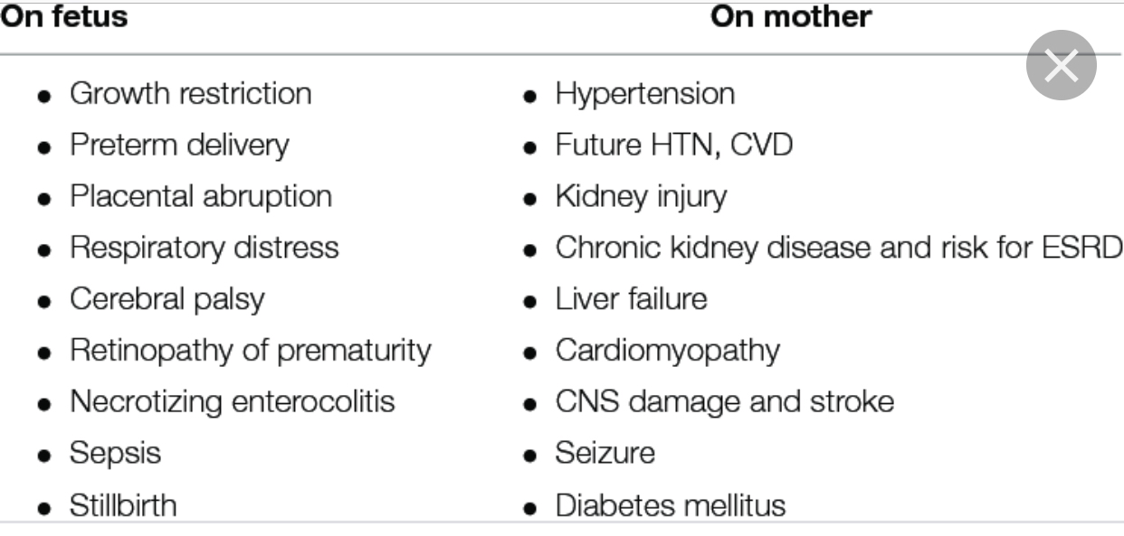
Aim of seminar
Effect of hypertension to fetus and mother

Slide 22
Clinical manifestation of each type
Symptoms | Preeclampsia | Eclampsia | Gestational | Chronic
B/P | 140/80mmHg | 160/110mmHg | 140/80mmHh | 140/80mmHg
Protein urea | Present | Present | No | No
Headache | Present | Present | Present | Present
Edema | Present | Present | No | No
Vision change | Present | Present | Present | Present
F.T | No | Present | No | No

Slide 23
References
Definition and classification of hypertension 1-fromhttps://emedicine.medscape.com/article/261435-overview#a1) 2-definition of preeclampsia and sign and risk factor(https://study.com/academy/lesson/what-is-preeclampsia-definition-causes-symptoms-treatment.html) 3- preeclampsia and eclampsia diagnosis and nursing role. ACOG Practice Bulletin No. 33. American College of Obstetricians and Gynecologists. 3-preclampsia treatment and eclampsia(https://www.mayoclinic.org/diseases-conditions/preeclampsia/diagnosis-treatment/drc-20355751) 4-nursing role and of(4. Caritis S, Sibai B, Hauth J, Lindheimer MD, Klebanoff M, Thom E, et al. Low-dose aspirin to prevent preeclampsia in women at high risk. National Institute ofChild Health and Human Development Network of Maternal-Fetal-Medicine Units. N Engl J Med 1998;338:701–5 5-sign and risk factors of eclampsia https://www.healthline.com/health/eclampsia 5-effect of hypertension during pregnancy Williams D. Long-. Semin Nephrol 2011;31:11 .1–22. [PubMe . 6-diagnosis and prevent and mangment of gestentaiol hypertension https://www.stanfordchildrens.org/en/topic/default?id=gestational-hypertension-90-P024 7-definite of gestentaiol hypertension and risk factors and sign https://en.m.wikipedia.org/wiki/Gestational_hypertension 8-nursing role of chronic hypertension https://www.medscape.com/viewarticle/463185_4 9-HEELPP syndrome WebMD Medical ReferenceReviewed by Traci C. Johnson, MD on December 11, 2017 10-control and prevent preeclampsia https://en.m.wikipedia.org/wiki/Pre-eclampsia 11-management of hellp syndrome https://www.ncbi.nlm.nih.gov/pmc/articles/PMC2654858/

